Slide 1
VDC: Versatile Data Cleanser based on Visual-Linguistic Inconsistency by Multimodal Large Language Models
Zihao Zhu¹, Mingda Zhang¹, Shaokui Wei¹, Bingzhe Wu², Baoyuan Wu¹
¹ The Chinese University of Hong Kong, Shenzhen
² Tencent AI Lab

Slide 2
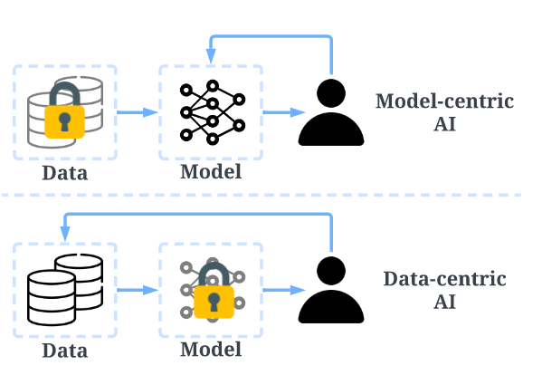
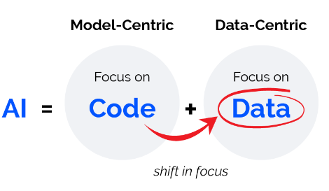
“Instead of focusing on the code, companies should focus on developing systematic engineering practices for improving data in ways that are reliable, efficient, and systematic. In other words, companies need to move from a model-centric approach to a data-centric approach.”
— Andrew Ng, CEO and Founder of LandingAI
What is Data-Centric AI?
Model-Centric
Data collection
Model training
Deployment
Data-Centric
Data collection
Model training
Deployment
Data is the new bottleneck for ML

Slide 3
“Instead of focusing on the code, companies should focus on developing systematic engineering practices for improving data in ways that are reliable, efficient, and systematic. In other words, companies need to move from a model-centric approach to a data-centric approach.”
— Andrew Ng, CEO and Founder of LandingAI
What is Data-Centric AI?

Slide 4
Challenges of Data-Centric AI
In the real world, dataset can be susceptible to undesirable flaws.
Crowdsourcing
Backdoor Attack
More Challenging Setting
Noisy Labels
Poisoned Samples
Hybrid Samples
cat
automobile
airplane
airplane
airplane
cat
bird
dog
airplane
airplane
bird
airplane
Dirty Samples

Slide 5
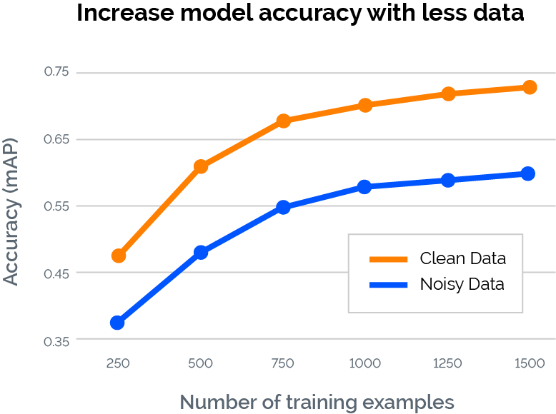
Negative Impact of Dirty Samples
Dirty samples makes the DNNs vulnerable and unreliable.
Benign
Poisoned
Backdoor Model
automobile
airplane

Slide 6
Limitation of Related Works
Poisoned Sample Detection
Noisy Label Detection
Require training on the poisoned dataset.
Require external clean dataset.
The performance depends on the types of poisoned samples.
Require training on the noisy dataset.
Require external clean dataset.
The performance depends on the types of noisy samples.
Existing poisoned sample detection and noisy label detection methods are limited to performing well in their respective domain.
This paper focuses on designing a universal detection framework capable of detecting various types of dirty samples simultaneously!

Slide 7
Versatile Data Cleanser (VDC)
Key Intuition: We find a notable commonality of noisy labels and poisoned samples lies in the semantic of visual modality and that of language modality of label does not match, even when the poisoned samples are embedded with triggers.
A photo of gray car and some noise.
Semantic of visual content
Poisoned Image
airplane
A type of aircraft.
Target Label
Semantic of label
Visual-Linguistic Inconsistency

Slide 8
Versatile Data Cleanser
How to measure the Visual-Linguistic Inconsistency is the key to detect dirty samples.
Given the exceptional capabilities of multimodal large language models (MLLM) in cross-modal understanding and reasoning, we resort to MLLM to measure this semantic inconsistency between modalities.
Ask insightful questions to inquire the semantic of the image.

Slide 9
Versatile Data Cleanser
Visual Question Generation (VQG)
Visual Question Answering (VQA)
Visual Question Evaluation (VQE)
VQG module first generates insightful visual questions related to the given labels based on the template and LLM.
Then VQA module resorts to MLLM to answer the generated visual questions about the image to acquire the semantics of the visual content.
The VAE module assesses visual-linguistic inconsistency by evaluating the matching score between the semantics of the image and label.

Slide 10
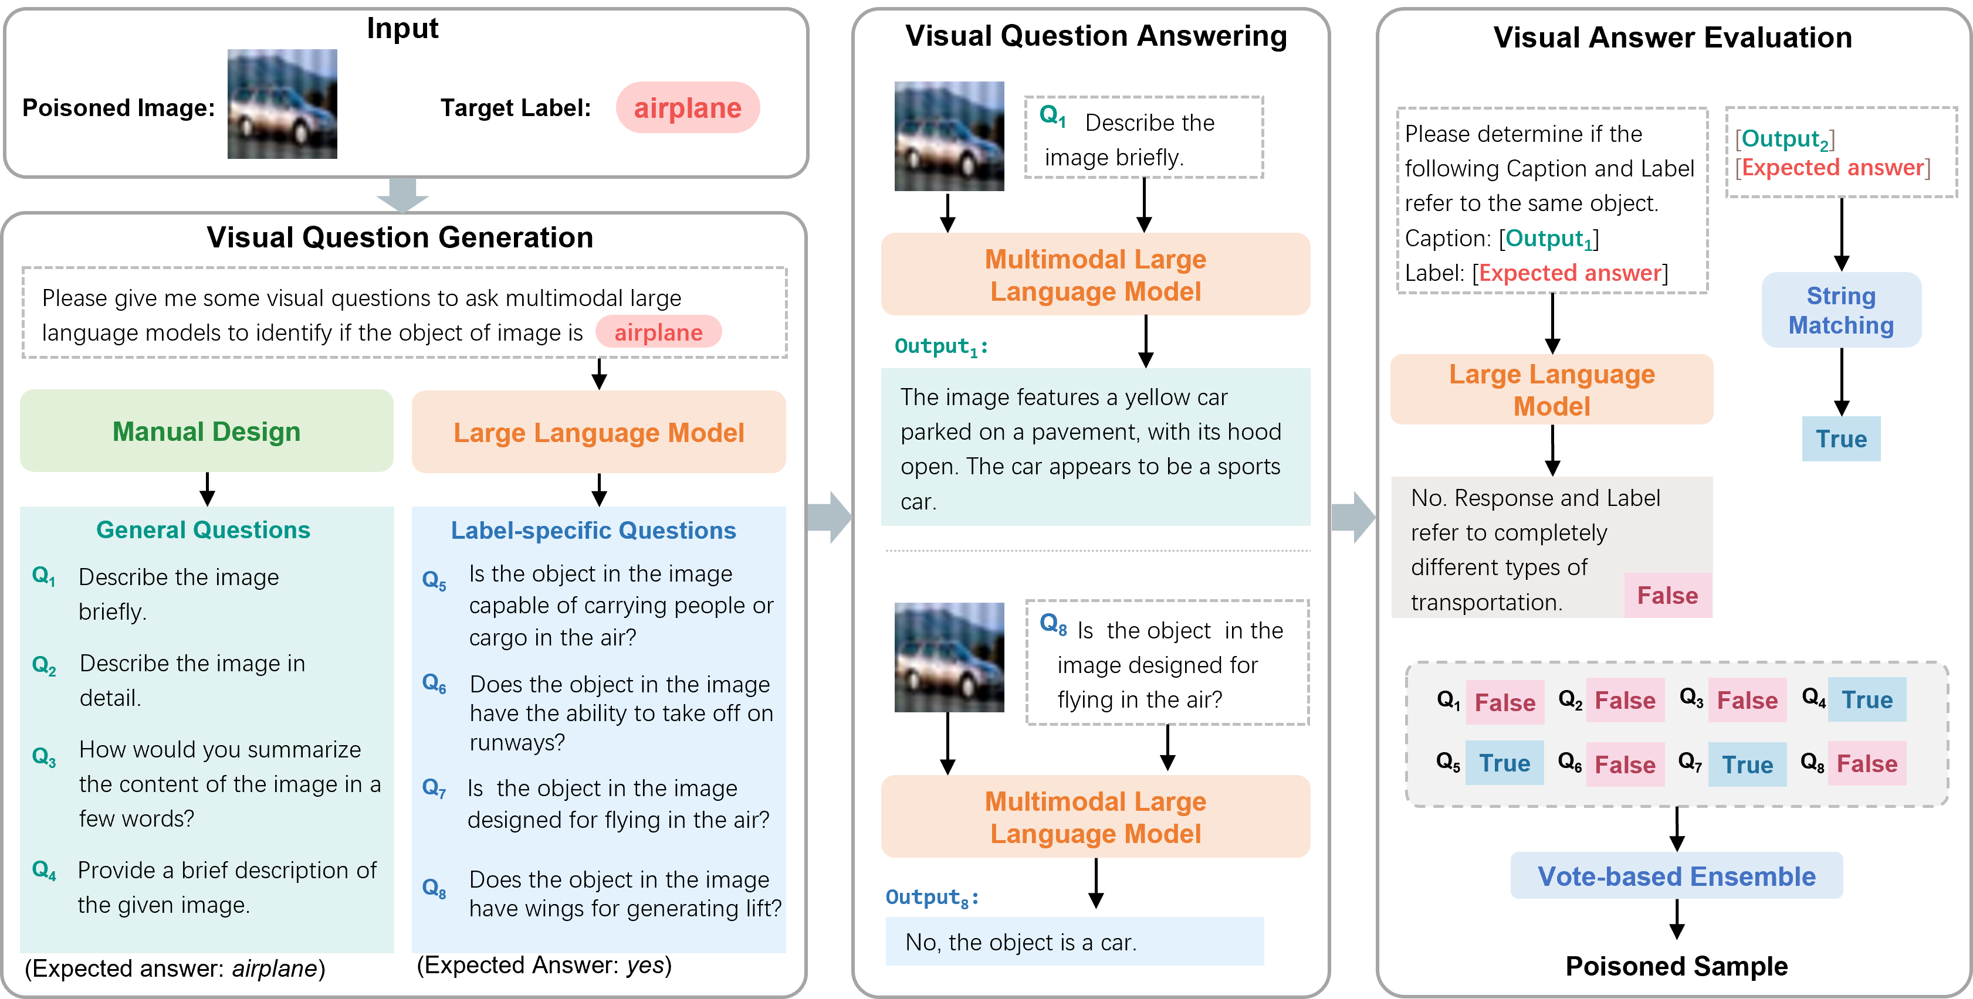
Versatile Data Cleanser

Slide 11
Versatile Data Cleanser
(1) General Questions
General questions can serve as a means to acquire holistic semantic understanding of an image from a global perspective, which are generated by pre-defined template.
(2) Label-specific Questions
Label-specific questions related to the given labels aim to extract more localized semantics from the image, encompassing aspects of commonsense features, attributions, functions, geography, history, culture, and etc, which are generated by LLM.

Slide 12
Versatile Data Cleanser

Slide 13
Versatile Data Cleanser
For label-specific questions with deterministic expected answers, we use string matching to evaluate the response. If the word “yes” is present in the response, the result should be true, otherwise if the response contains the word “no”, the result should be false.
For general questions, string matching is insufficient to determine correctness. In such cases, we employ LLM as a specialized evaluator through meticulously designed prompts, which is a commonly adopted approach in the evaluation of NLP.
Vote-based Ensemble. The matching score is computed as the proportion of questions answered correctly.

Slide 14
Experiments
Dataset
CIFAR-10, ImageNet-100, ImageNet-Dog
Evaluation Metrics
True positive rate (TPR) means the recall of detected dirty samples, representing the capacity to successfully detect dirty samples within the dataset.
False positive rate (FPR) denotes the ratio of clean samples erroneously identified as dirty samples, highlighting the susceptibility to produce false alarms.
Goal:
High TPR & Low FPR

Slide 15
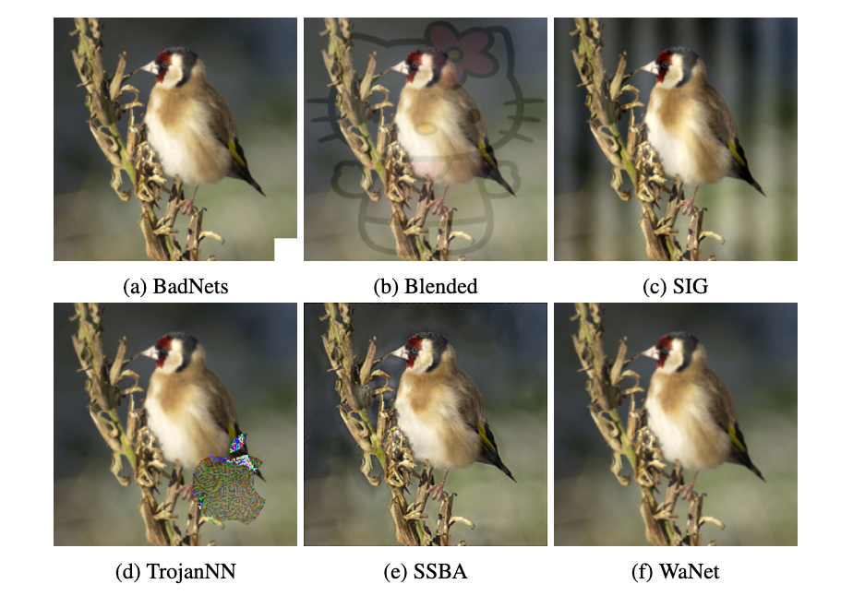
Experiments
Examples of Various Poisoned Samples

Slide 16
Experiments
Results of Poisoned Sample Detection

Slide 17
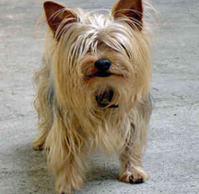
Experiments
Results of Poisoned Sample Detection
If the similarity of classes will affect the performance?

Slide 18
Experiments
Results of Noisy Label Detection
Symmetric noisy label is generated by uniform flipping, i.e., randomly flipping a ground-truth label to all other possible classes.
Asymmetric noisy label is generated by flipping the ground-truth label to the next class, i.e., (i mod K) + 1

Slide 19
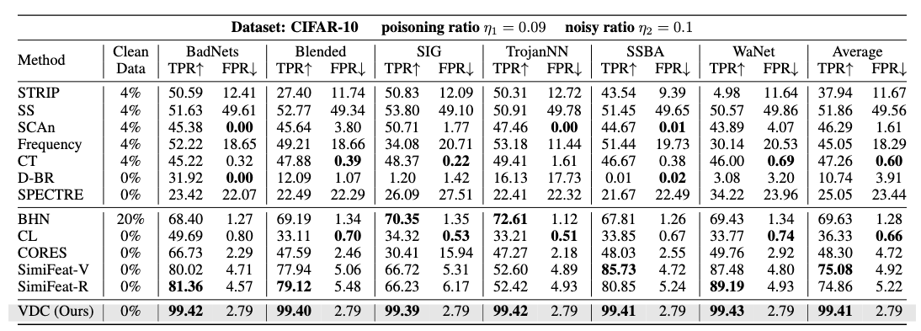
Experiments
Results of Detecting Hybrid Dirty Samples

Slide 20
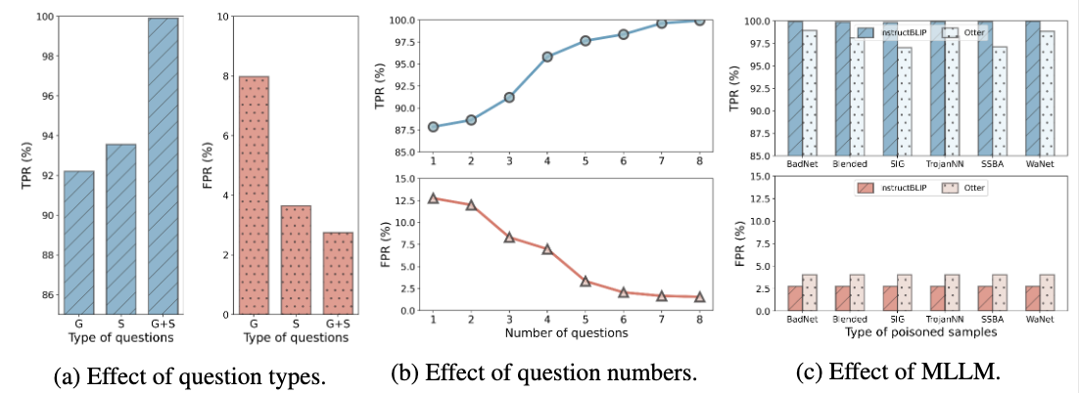
Experiments
Ablation Study

Slide 21
Thanks for your attention!
Paper : https://openreview.net/forum?id=ygxTuVz9eU
Code: https://github.com/zihao-ai/vdc
Website: https://versatile-data-cleanser.github.io/

